Slide 1

Mendel University in Brno

Slide 2



About university
founded in 1919 as the University of Agriculture
currently consists of 5 faculties and 1 institute:
Faculty of AgriSciences
Faculty of Forestry and Wood Technology
Faculty of Business and Economics
Faculty of Horticulture
Faculty of Regional Development and International Studies
Institute of Lifelong Learning
two school enterprises

Slide 3
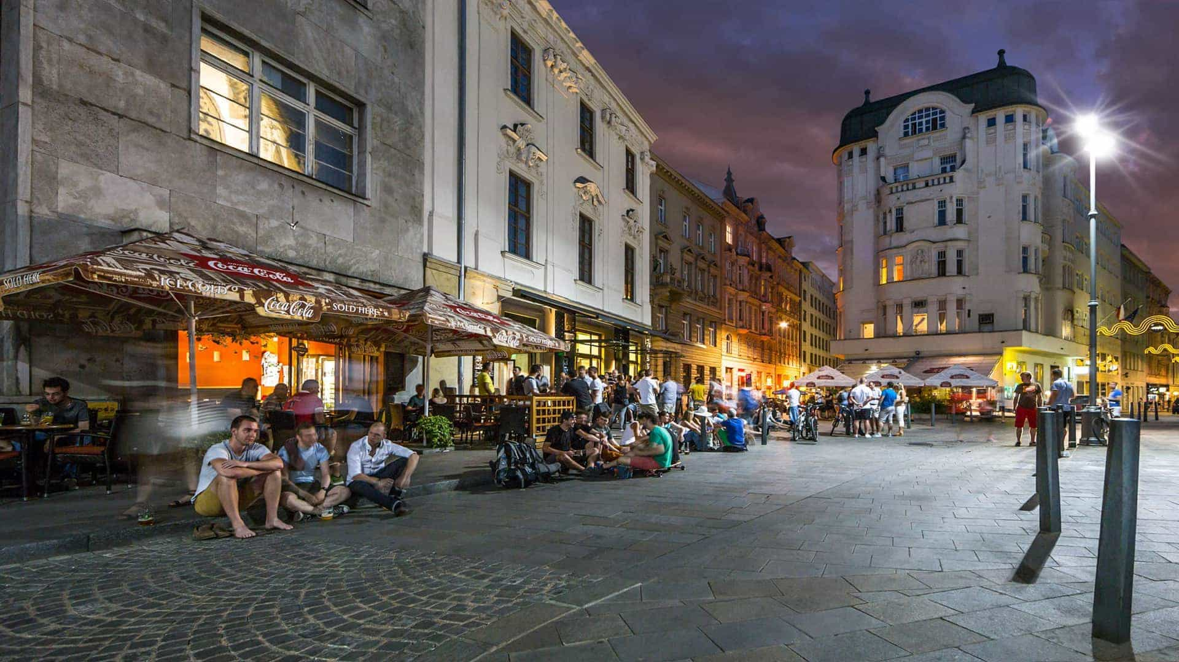
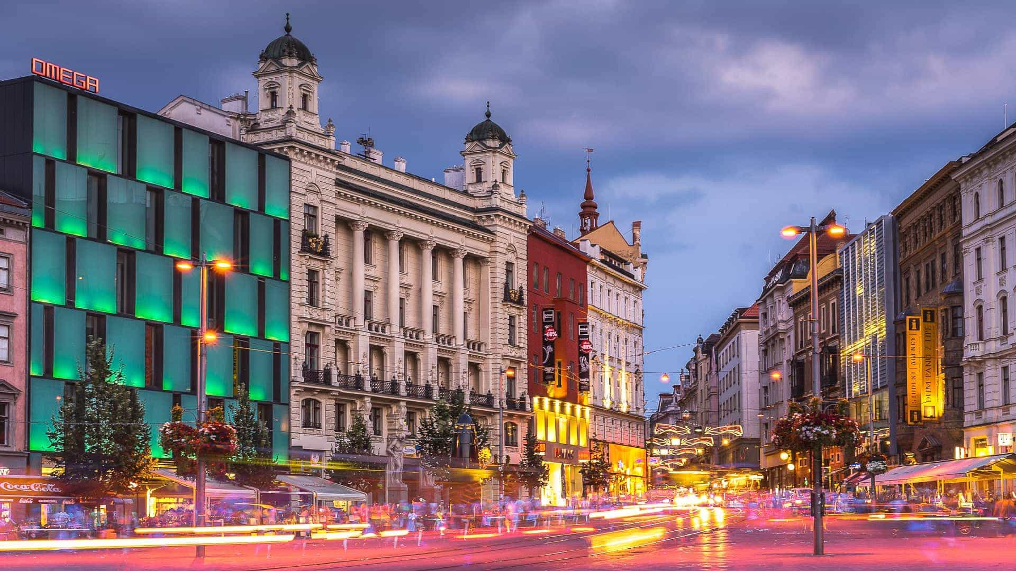
About Brno
over 65,000 students study at universities in Brno
nearly a quarter of them come from abroad
in 2023, Brno was ranked the 4th best student city in the world by Campus Advisor

Slide 4
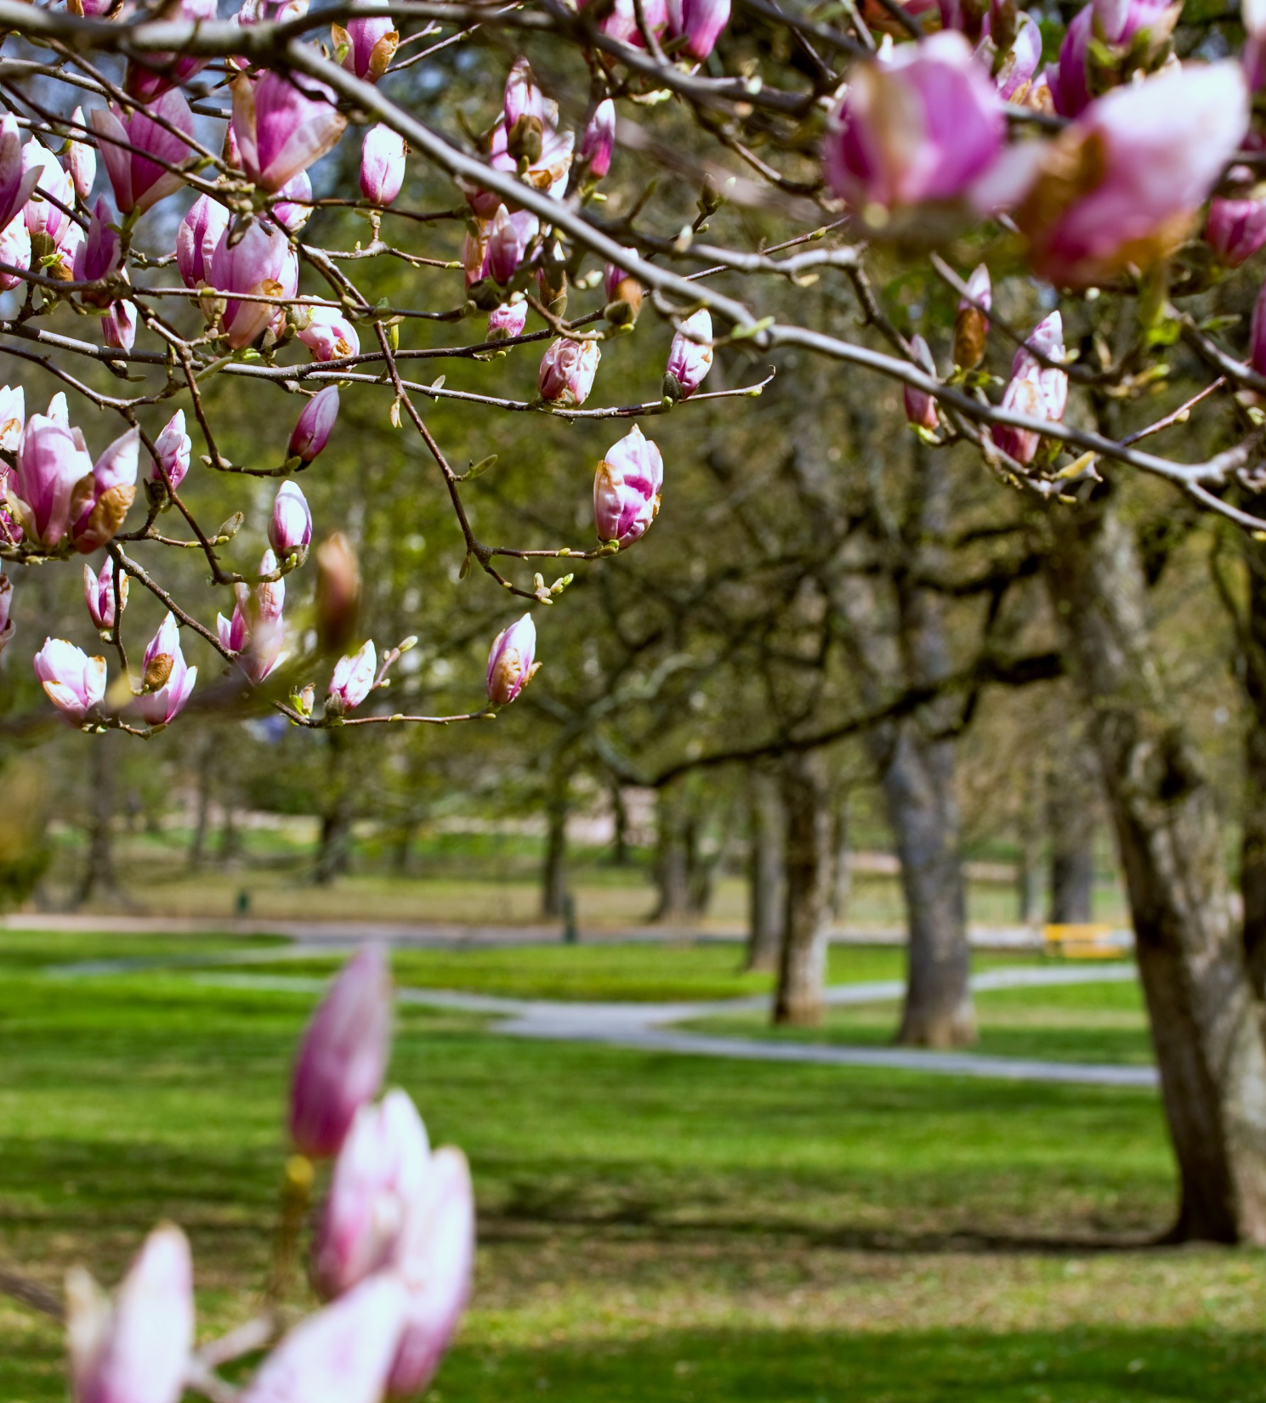
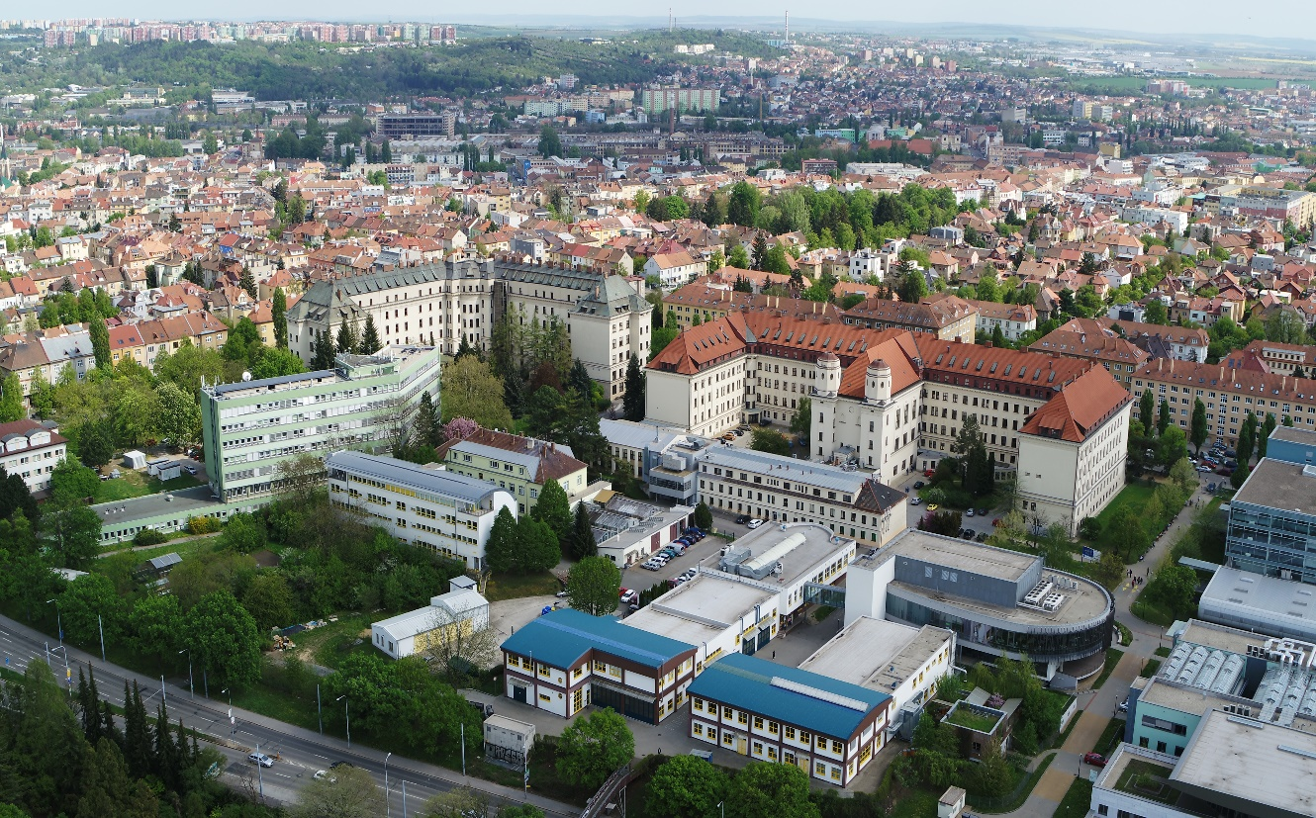

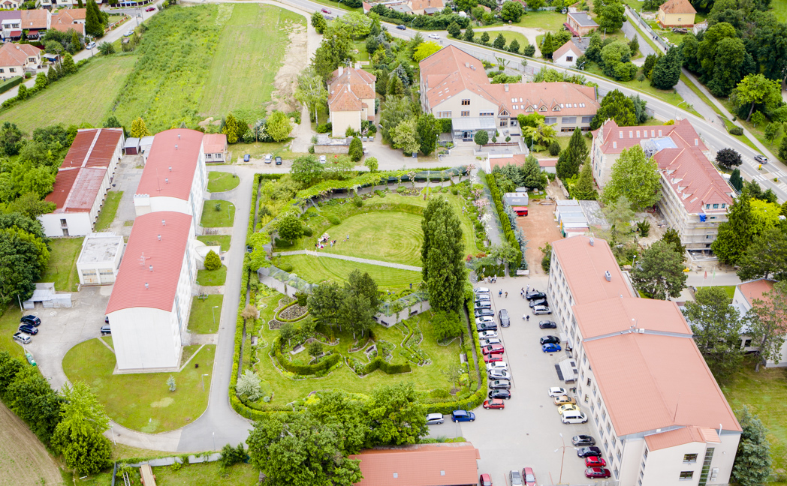
University campus
faculties are located in one campus in Brno with the exception of the Faculty
of Horticulture, which is located in Lednice (60 km)
student dormitories, shops, cafes and parks are close to the campus
MENDELU campus in Brno
Faculty of Horticulture

Slide 5
Parts of the University
MENDELU owns unique facilities that play an important role in practical teaching
and learning, including research tasks and thesis solutions
MENDELU Botanical Garden and Arboretum
University Enterprise Masaryk Forest Křtiny
School farm Žabčice

Slide 6
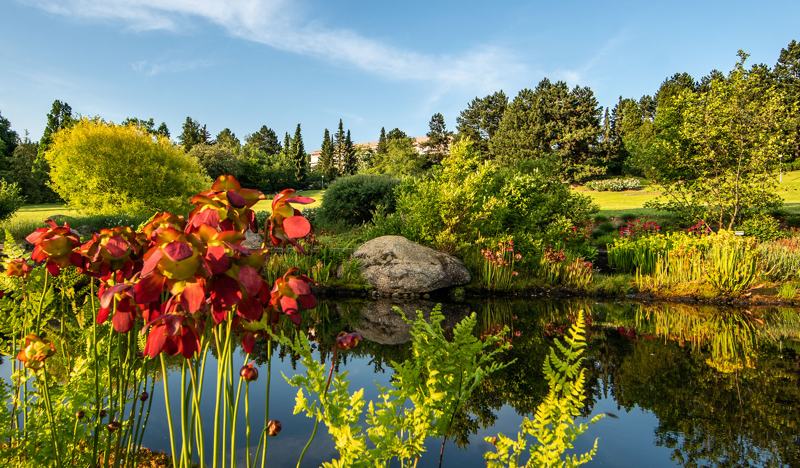
MENDELU Botanical garden and arboretum
founded by prof. Ing. August Bayer in 1938
the 11-hectare site is divided into five thematic sections
the collection of orchids is one of the largest in Europe - 2000 natural species and 3 thousand hybrids, it includes a genebank of orchids. Public exhibitions - Orchids, Irises, Colours
of Autumn, Summer Weekend...

Slide 7
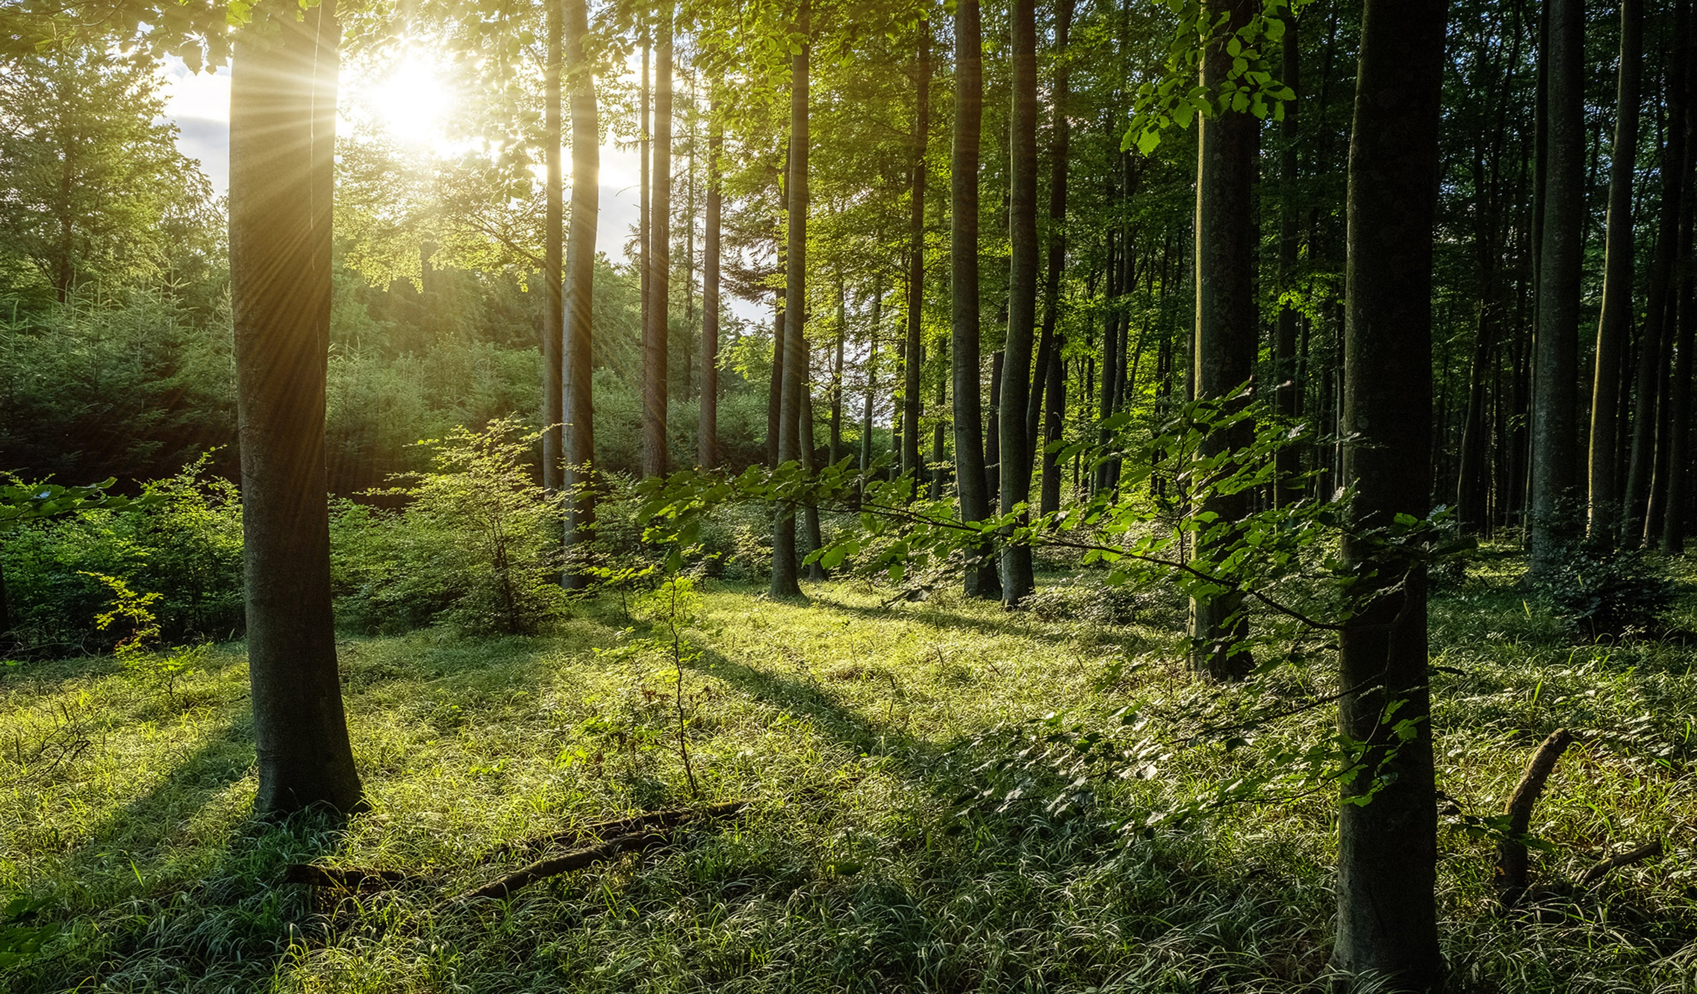
School Forest Enterprise Masaryk Forest Křtiny
it includes nearly 10,000 hectares of mixed forests in which biodiversity plays a major role.
it includes three arboretums, fifty wells and 90 monuments
of the Forestry Memorials. Within the Excellentia project, it is
a monitoring site for projected climate scenarios for Central European forests.
the activities of ŠLP Křtiny also include forest pedagogy, building and maintaining nature trails, running the Křtiny Chateau Hotel and commercial activities.

Slide 8
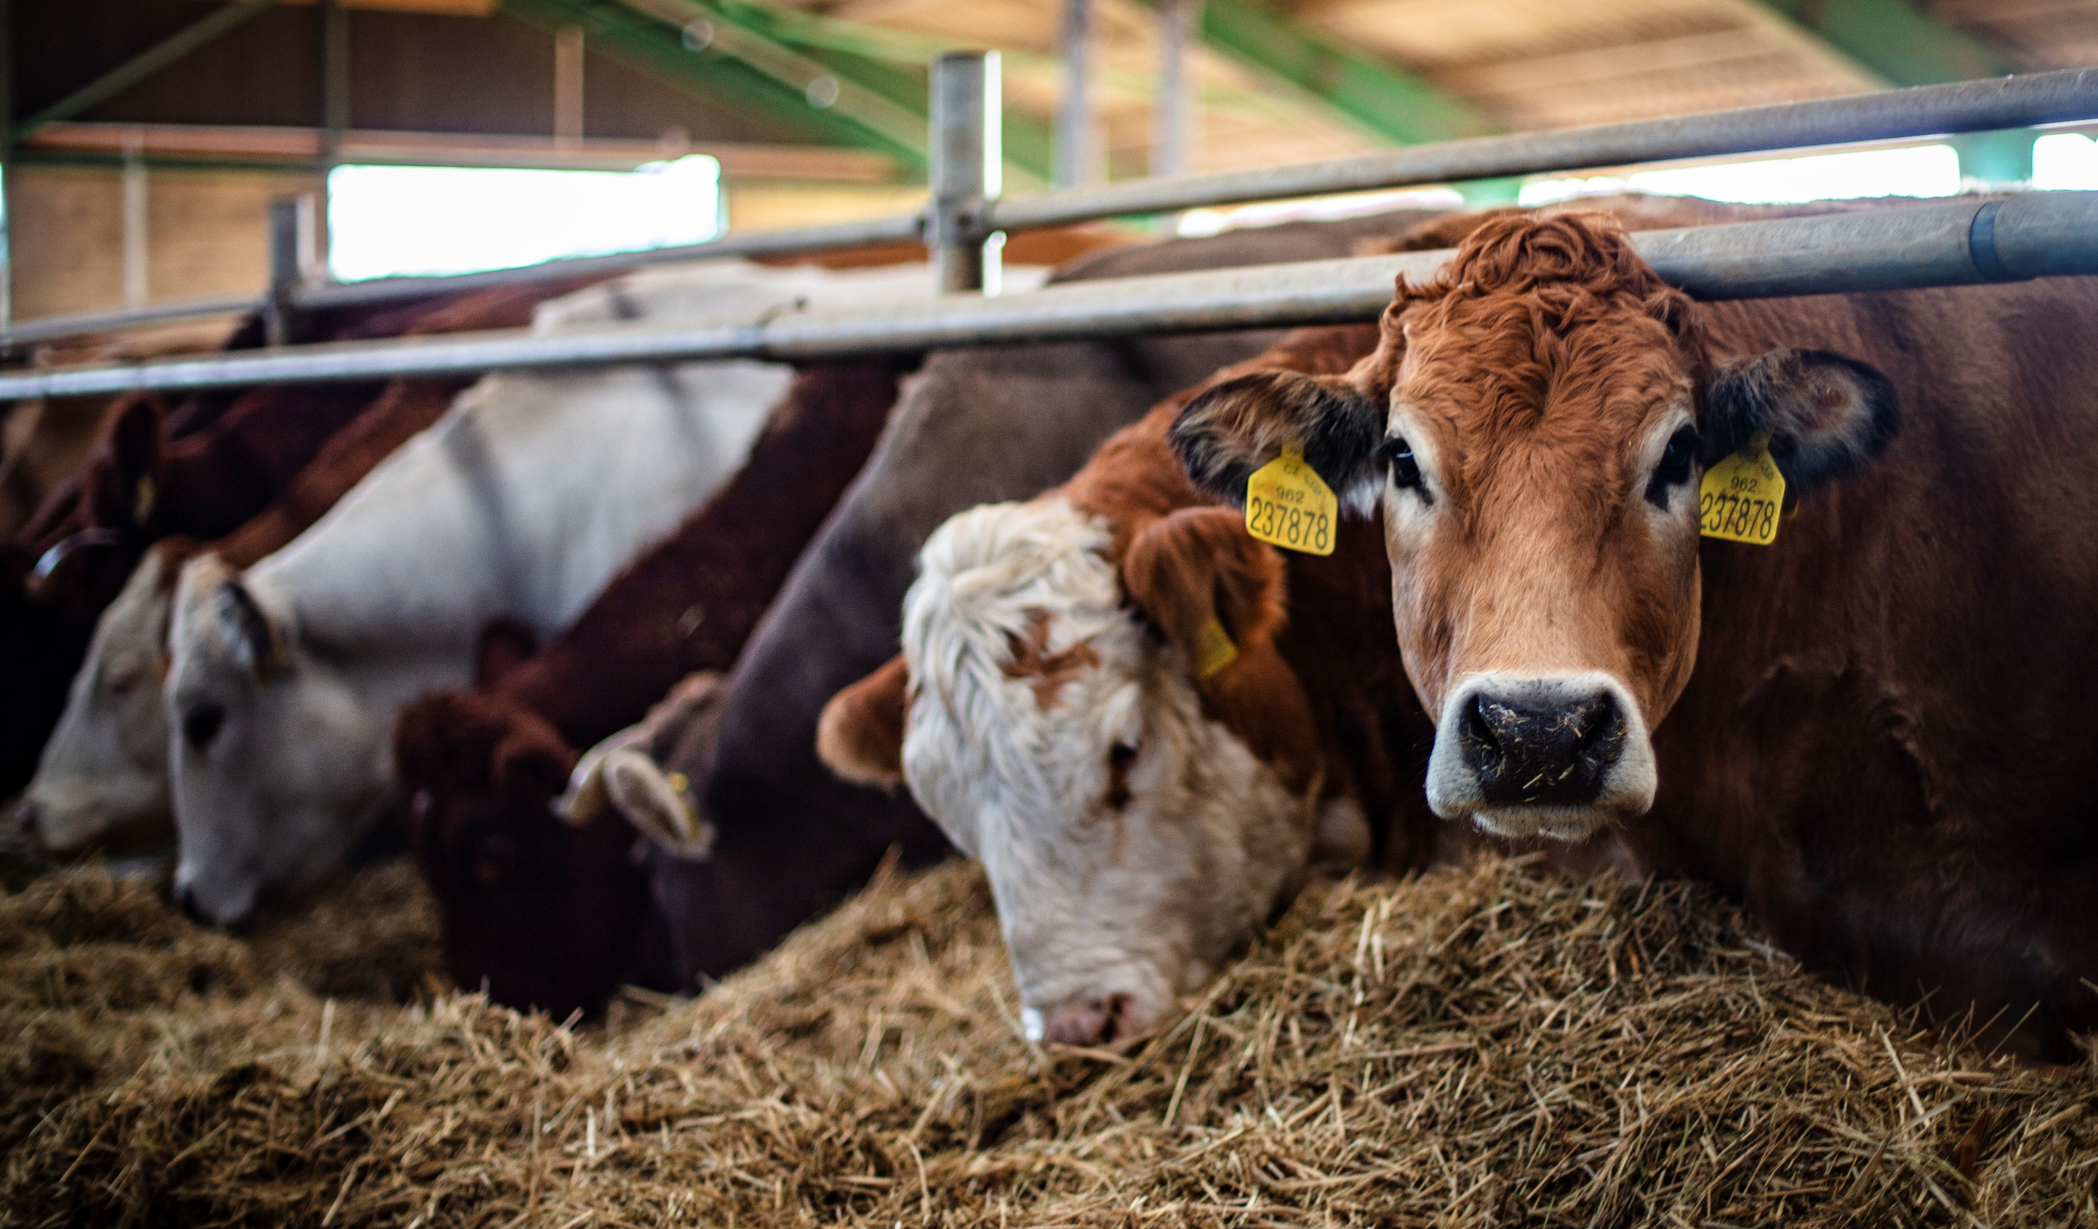
School farm Žabčice
raising approximately 1200 cattle, including 700 Holstein dairy cows, 100 beef cattle and 400 calves and heifers
fifteen breeds of beef cattle are used to teach students and to produce breeding stock for herd renewal and breeding stock sales​
ŠŽP Žabčice manages 2300 ha of agricultural land, including 10 ha
of vineyards in the locality of Žabčice and Lednice, including a demonstration farm and a field experimental station
it organises regular public events MendelAgro and MendelSun

Slide 9
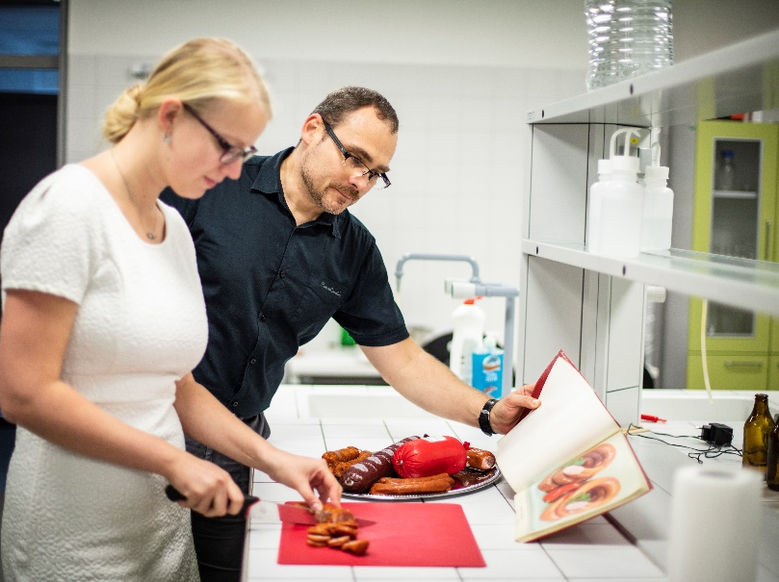
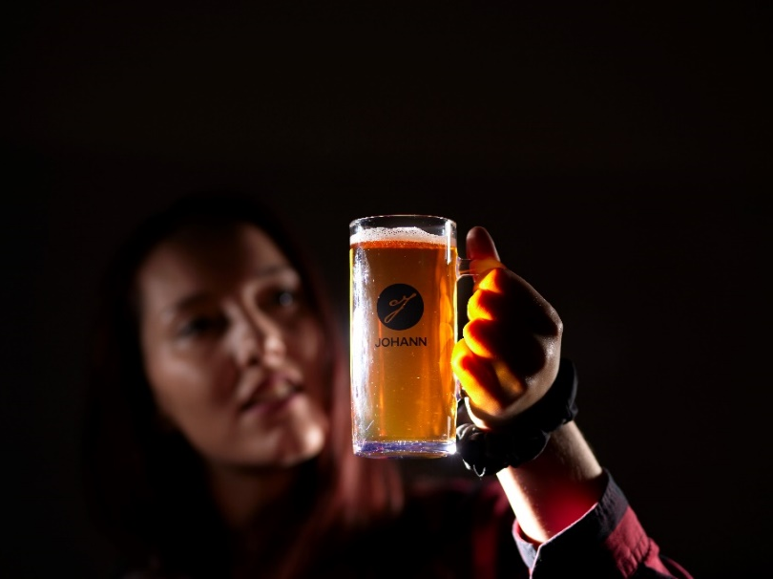
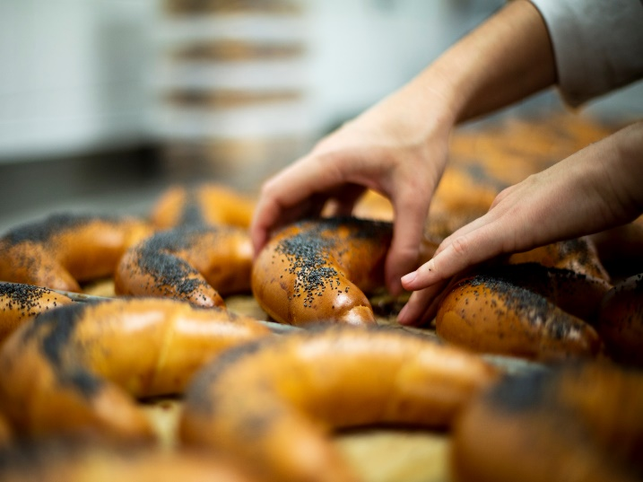
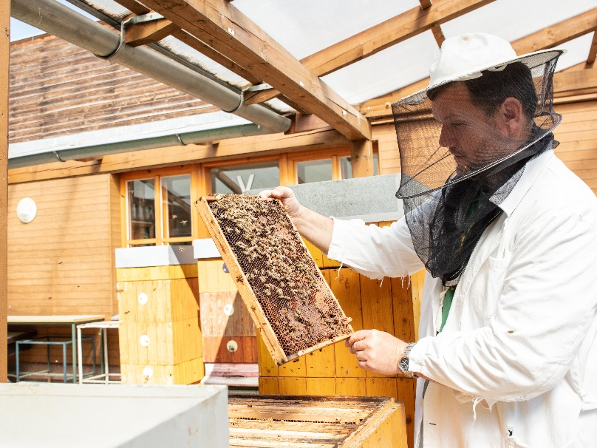
MENDELU semi-operations - brewery, dairy, bakery, meat production ​
linking theoretical knowledge with practical experience, developing students' skills and preparing them for practice
practical teaching, research, preparing students
for the work environment.

Slide 10
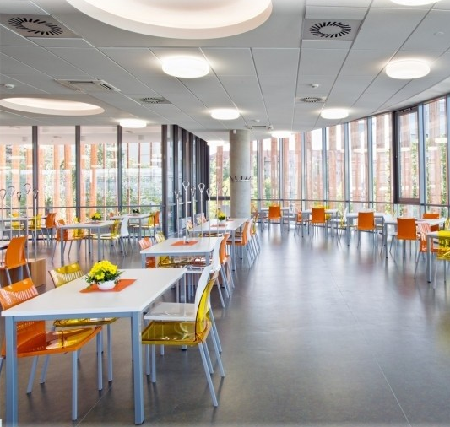
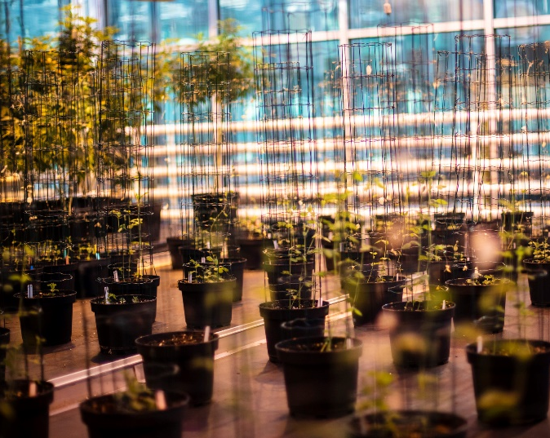
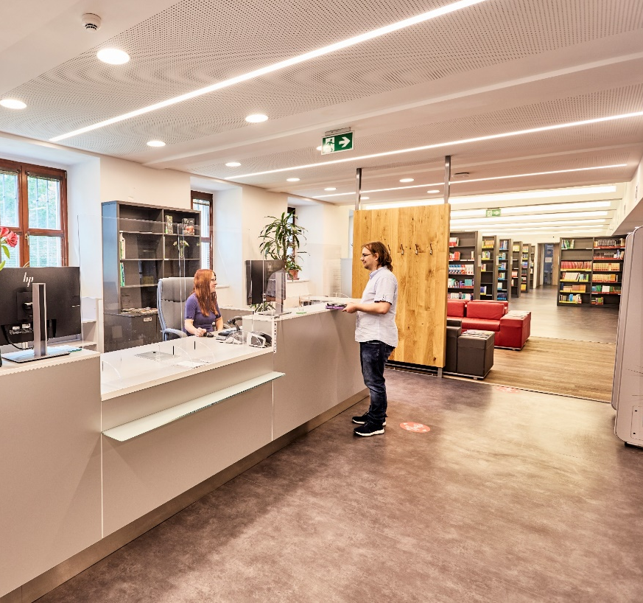
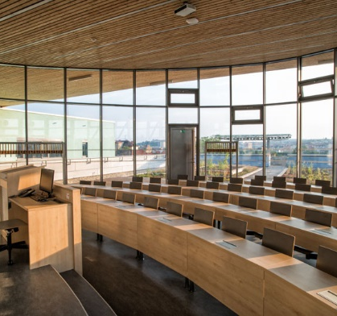
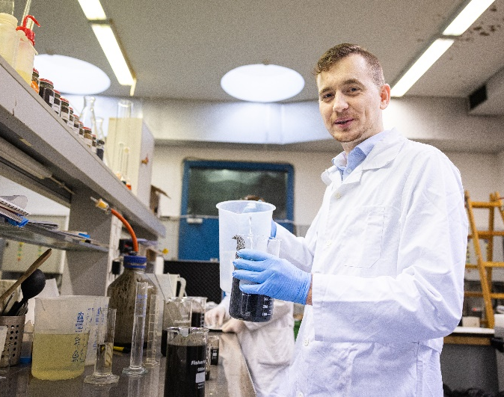
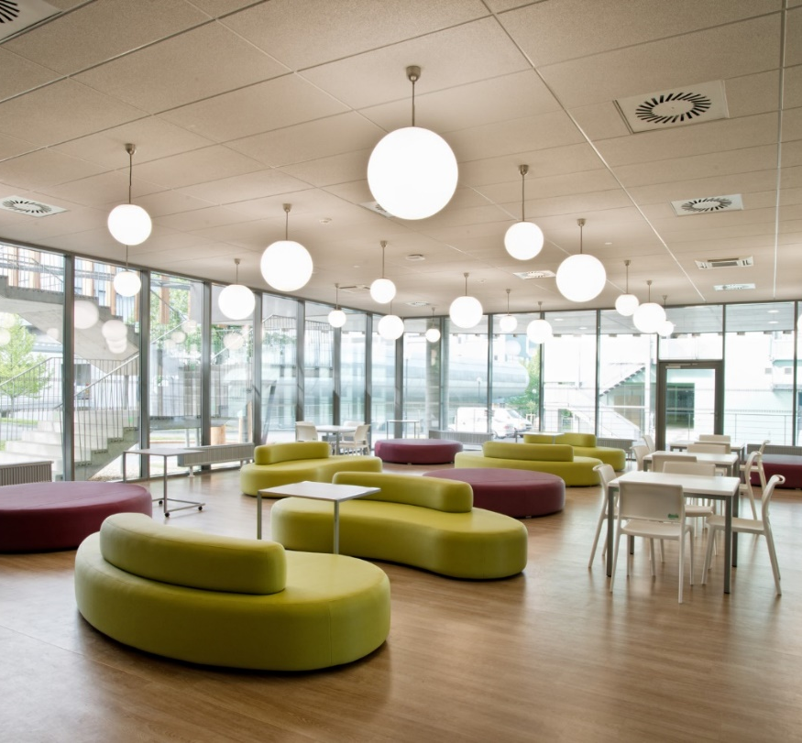
greenhouses and phytotrons
library
canteens
laboratories
study rooms
modern lecture rooms

Slide 11
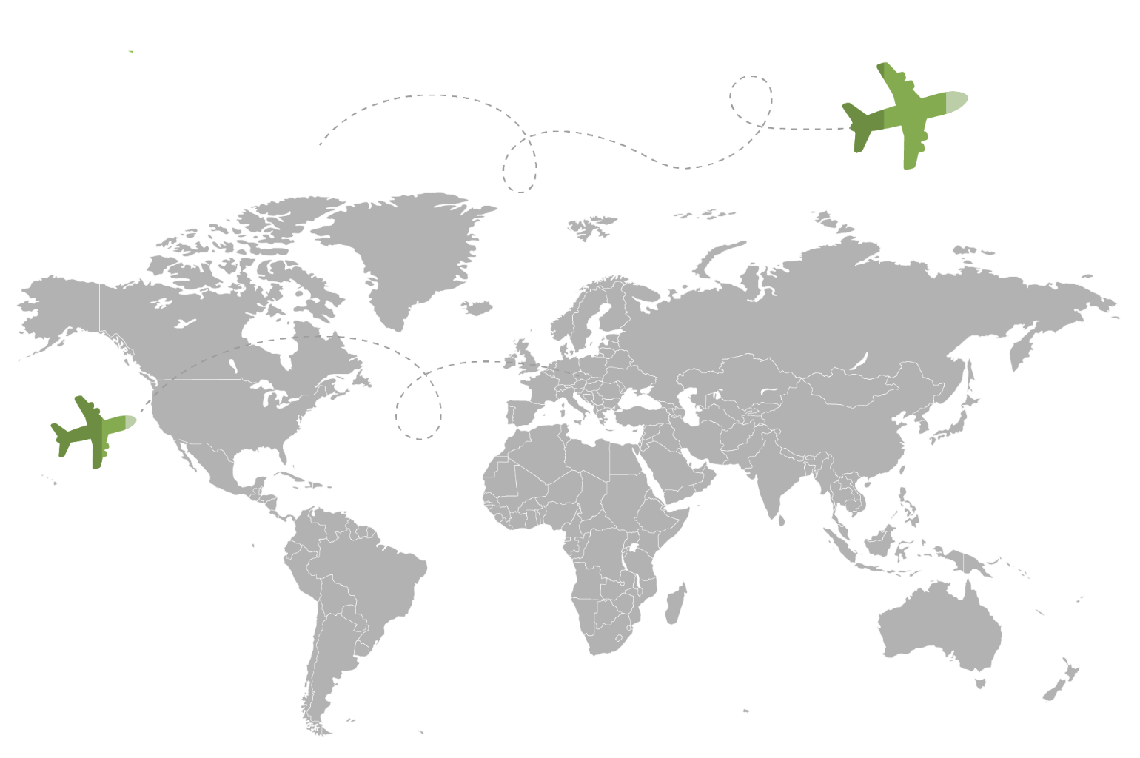
Internationalisation
departured in 2024
363 students
510 employees
363
mobilities
arrivals and departures
to 90 countries worldwide
MENDELU's most important partners outside the EU include Louisiana State University in the USA and Kasetsart University in Thailand
the university cooperates and solves projects in Nicaragua, Peru, Thailand, South Africa and the Philippines
admitted
377 students
288 employees*
*departures of at least 5 days

Slide 12
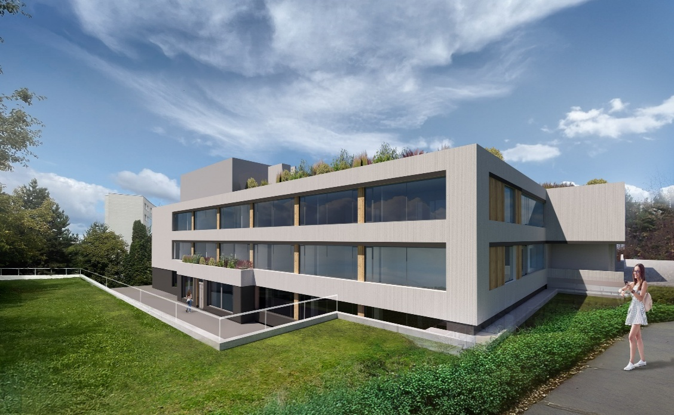
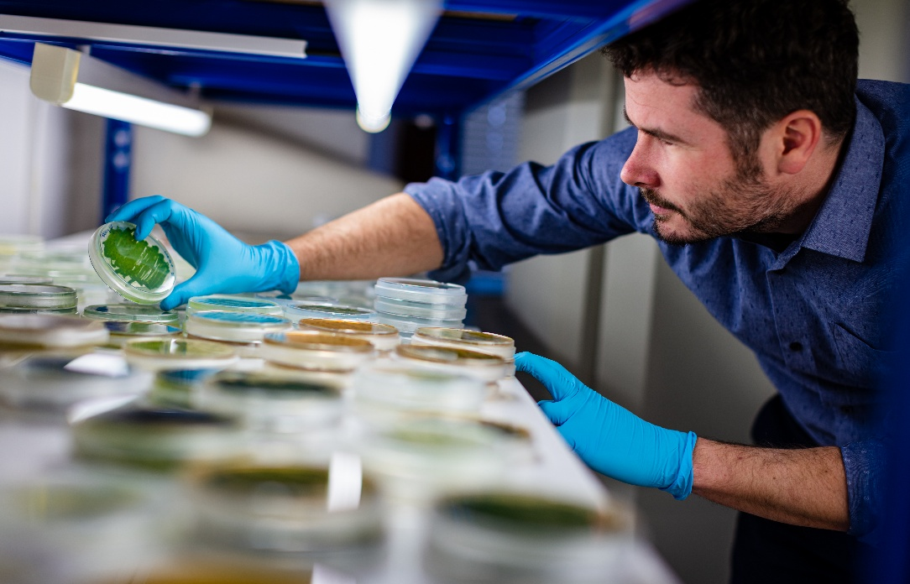
Science and research
OP JAK
MENDELU will improve accessibility, expand facilities for students, and support the field
of education through the Jan Amos Komenský Operational Programme.
TA CR SIGMA
the aim of the call is to evaluate and subsequently transform the achieved research and development results into practical applications, enabling their real commercial use, all implemented through Sub-projects.

Slide 13
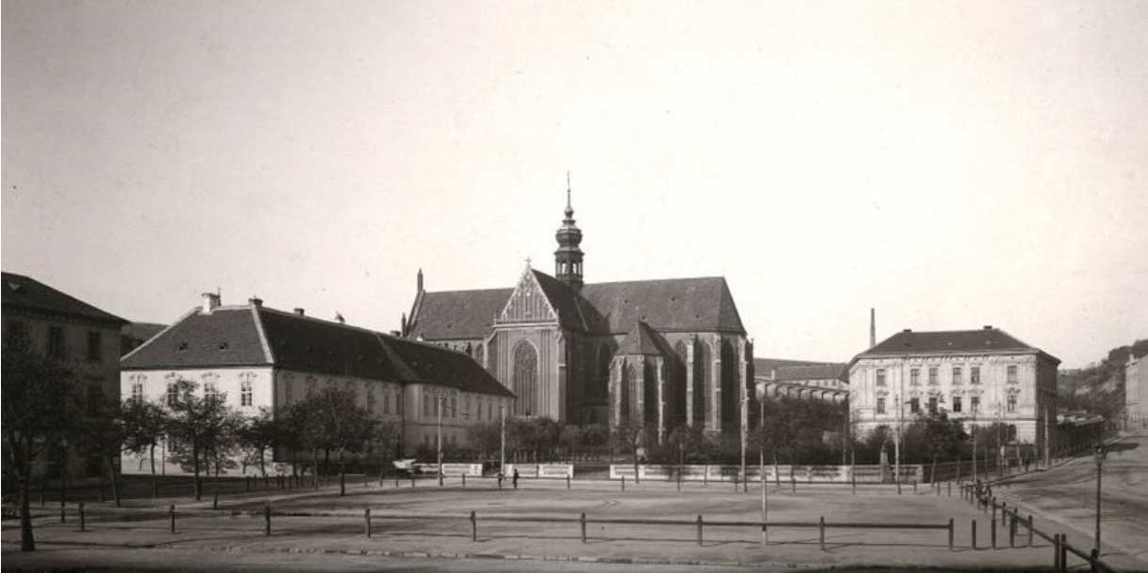


Gregor Johann Mendel
(* 1822 Hynčice in northern Moravia – † 1884 Brno)
father of genetics, meteorologist and beekeeper
monk and later abbot of the Augustinian monastery in Old Brno

Slide 14
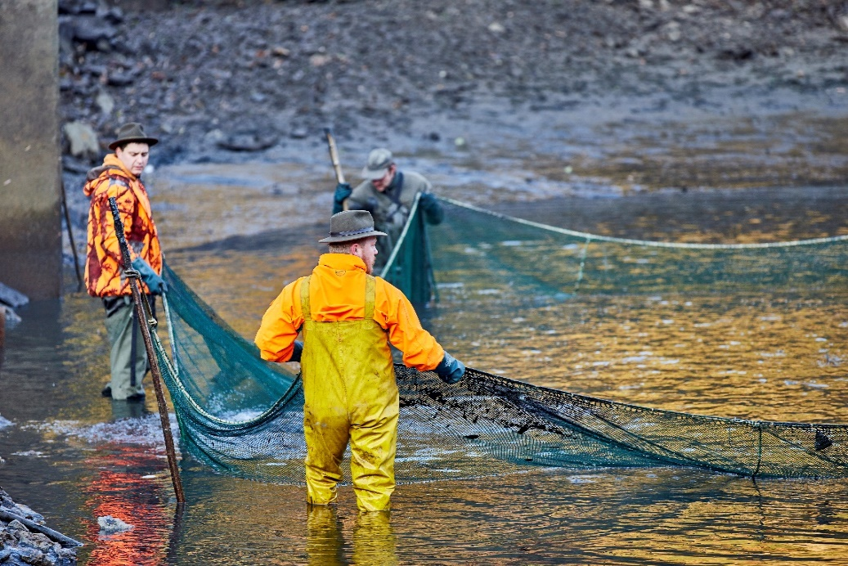
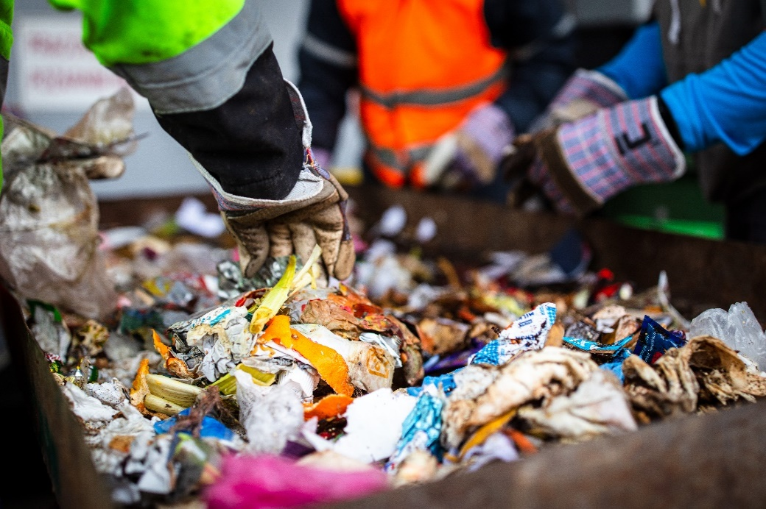
The third role of MENDELU
Promotion of freshwater fish consumption
we provide professional supervision
and certification of freshwater fish suppliers
to the Albert supermarket.
Reducing food waste
as part of our research, we collect data on how behavioural changes can affect waste management. We share
the findings with waste management companies for use.

Slide 15

Sustainability at MENDELU
MENDELU sustainability priorities:
education
science and research
social responsibility
collaboration
and partnerships
resources for change
We are commited to the UN goals
„I believe that the study and science of Mendel University will inspire the change in thinking that we urgently need for sustainable life on our planet.„
                - Jan Mareš, rector

Slide 16

Vocational Training Centre Water in the Landscape
centre for Water Management Education
at MENDELU, which promotes innovative approaches in water management education. It targets students, teachers, professionals
and the general public ​
examples of activities include Water Days –
an international educational event for secondary school students from Europe organised
on the occasion of World Water Day
or the organisation of the Czech national round
of the Stockholm Junior Water Prize competition for secondary school students

Slide 17
Development cooperation in Africa, Latin America and Asia
active development cooperation and aid in Africa, Latin America and Asia
development projects with scientific and private entities
linking collaborations between academics from many disciplines across faculties

Slide 18
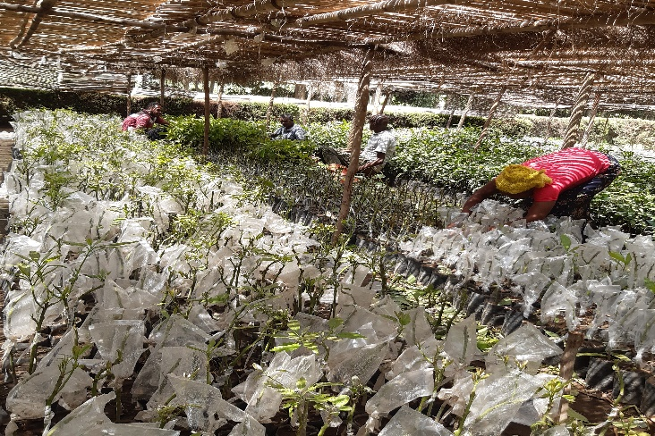
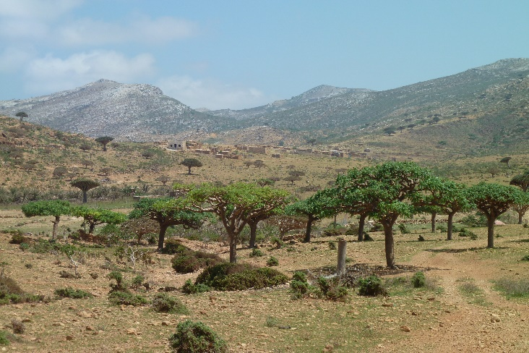
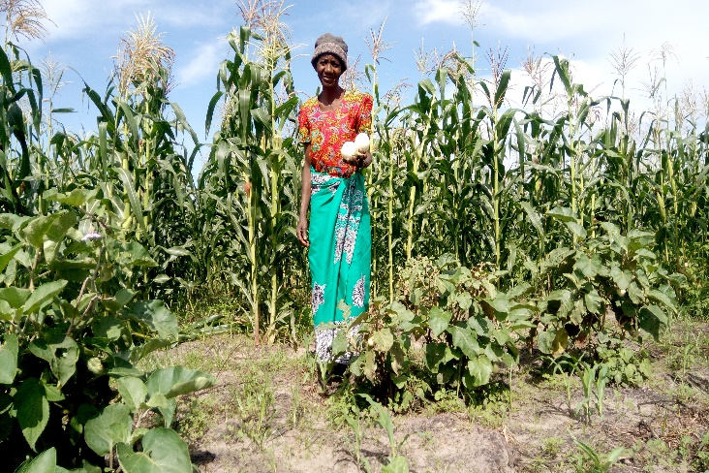
Development cooperation in Africa, Latin America and Asia
Ethiopia​
silvopastoral systems as a strategy
for sustainable agriculture / integrated farming / conservation of Lake Awassa
Sokotra Island​
help with biodiversity conservation
and reforestation / inventory
and promotion of home and school gardens
Zambia
silvopastoral systems / integrated farming / quality improvement of the forestry program at the Faculty of Natural Resources
at Copperbelt University

Slide 19
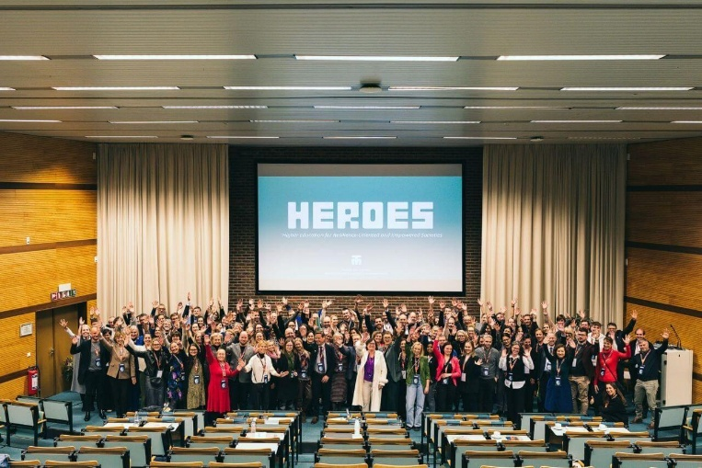
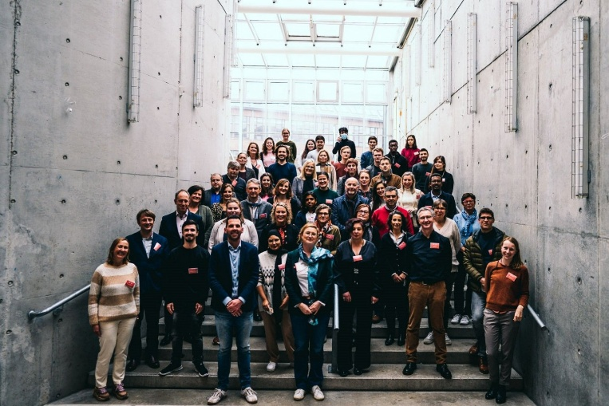
HEROES
HEROES Alliance brings together 9 European universities
of applied sciences with the aim of strengthening regional resilience through digital innovation.
the alliance includes 120,000 students and 14,000 staff across 22 campuses in predominantly non-urban areas.
cooperation in education, including e-learning, blended learning, and COIL, as well as the exchange of teachers
and students (including students with special needs), focused on development and innovation.

Slide 20
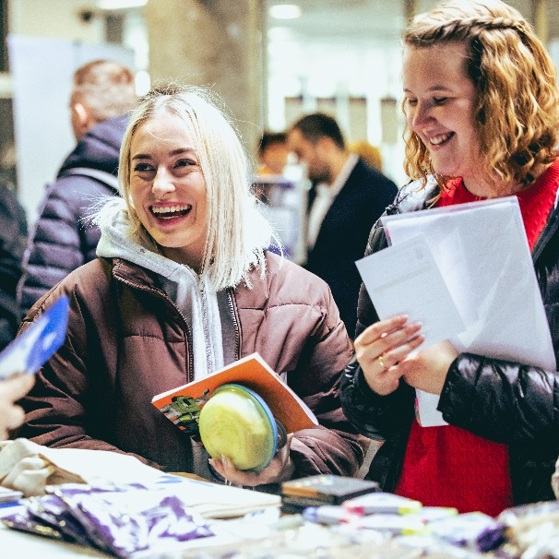
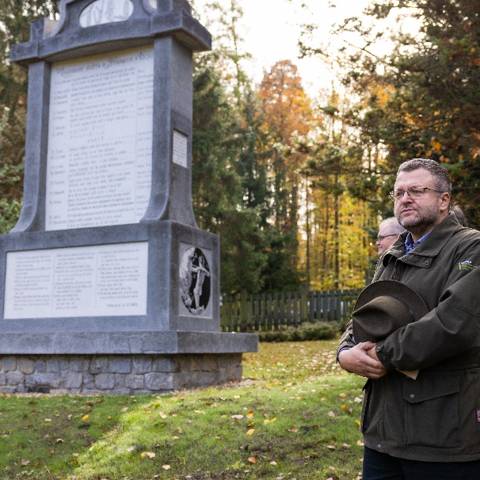
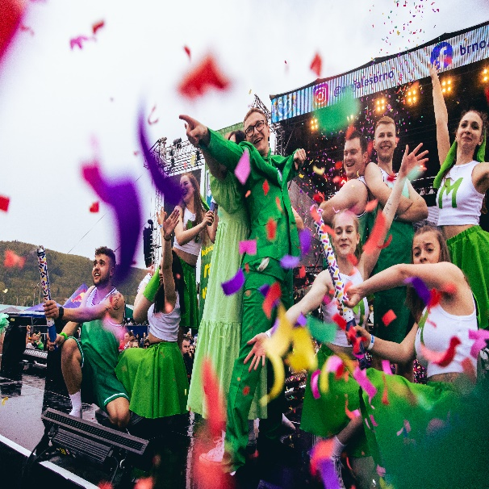
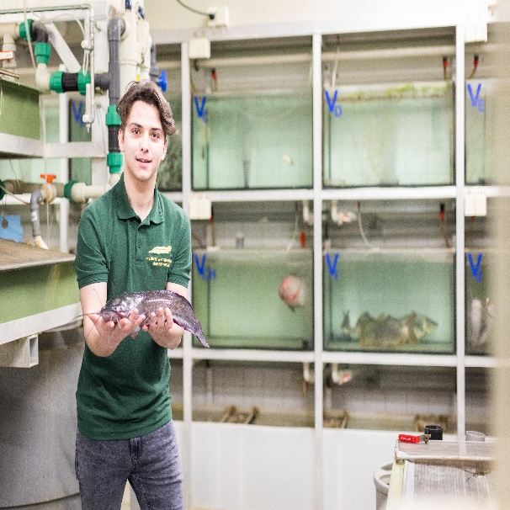
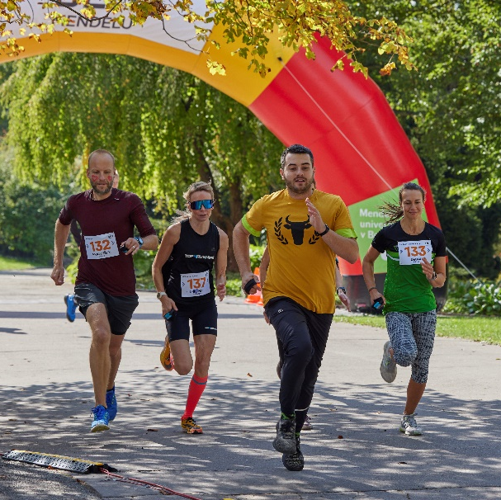
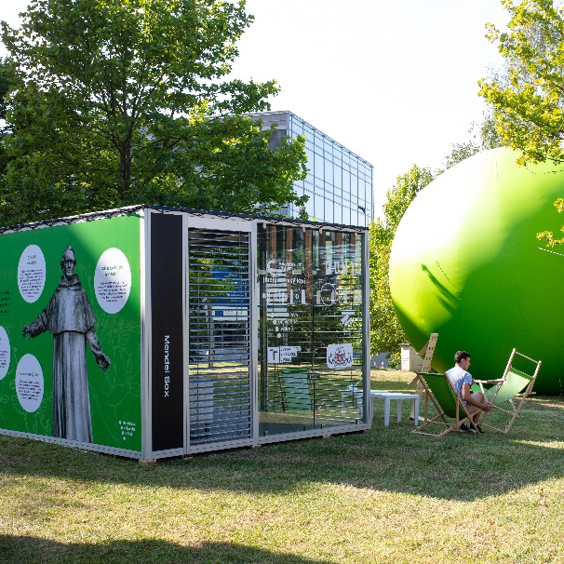
Events
at MENDELU
balls, Career Day, Majáles, outdoor events and sporting events

Slide 21
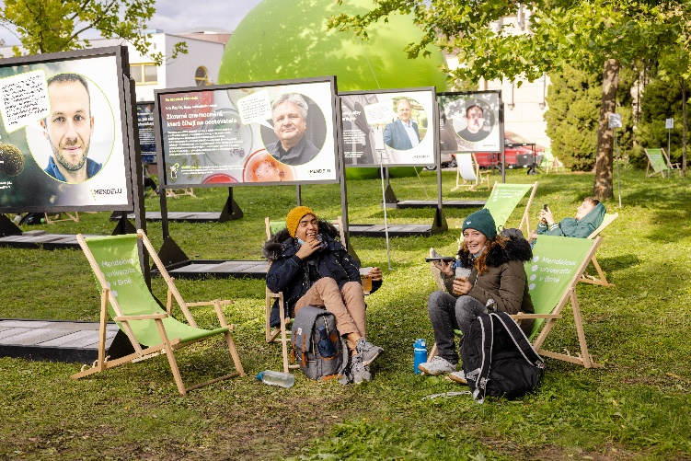
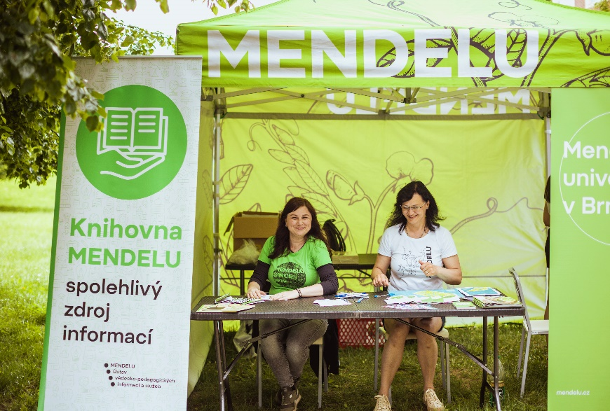
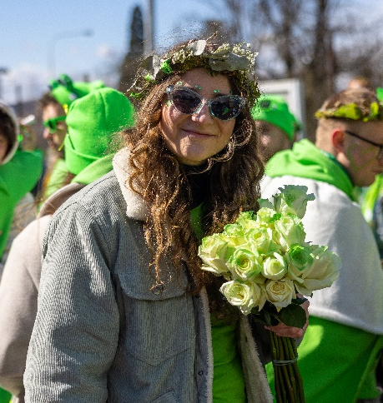
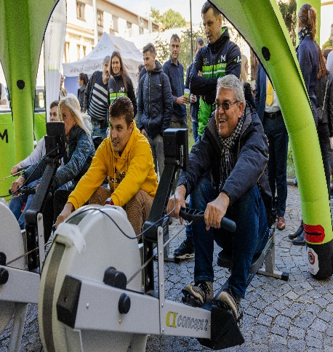
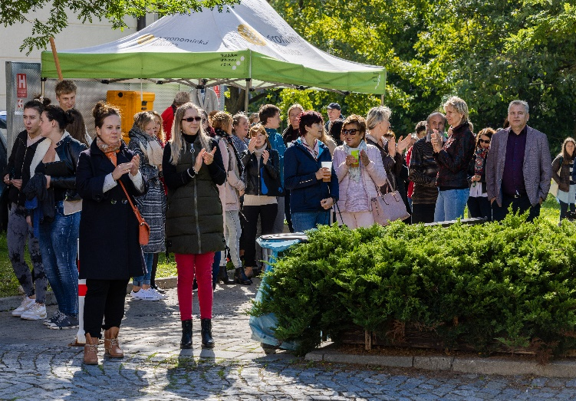
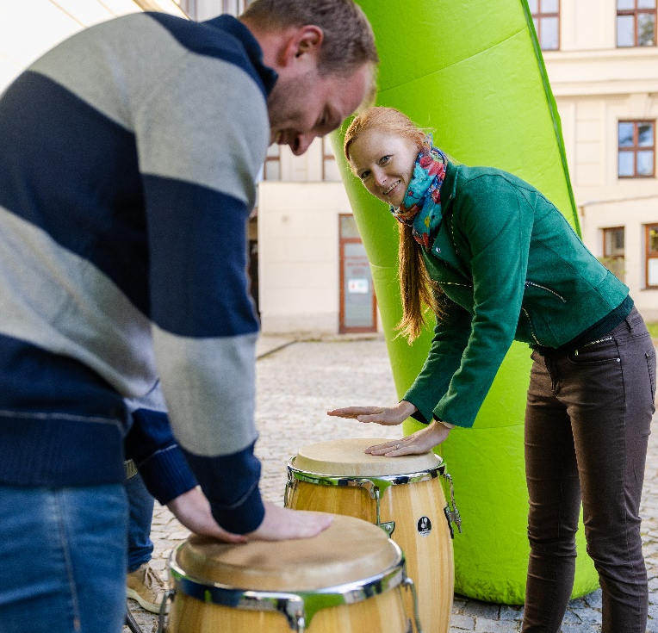
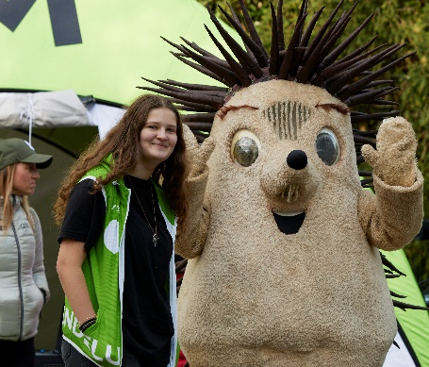
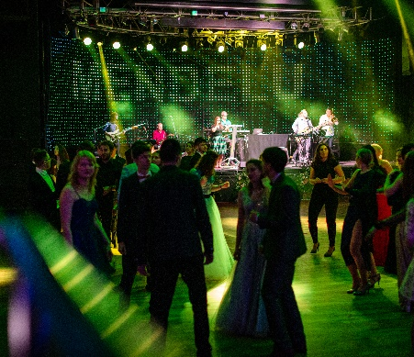
MENDELU Community
number of students: 9 279, of which 14.9 % are international
number of employees: 1915
Career development, Events for staff and students - MENDELU party, MENDELU Run, support for student events - Majáles

Slide 22
Thank you for your attention.
Mendel university in Brno

